Slide 1
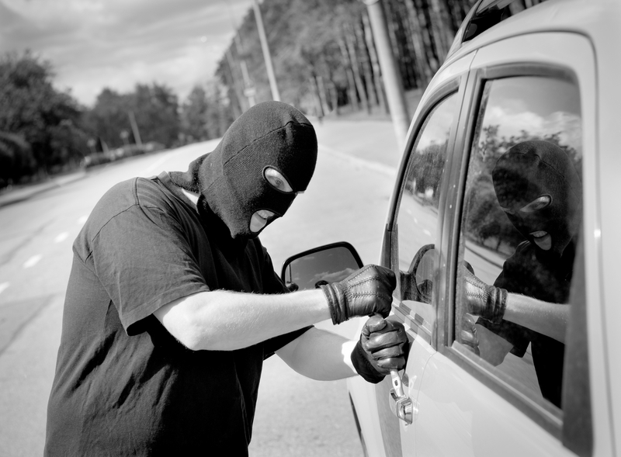
Thief's/ Digital Community Project
By Trent Zeitler Jashara Conley PS Hear is a video of a thief who got what he deserved->https://www.youtube.com/watch?v=zg6epfr73vA

Slide 2
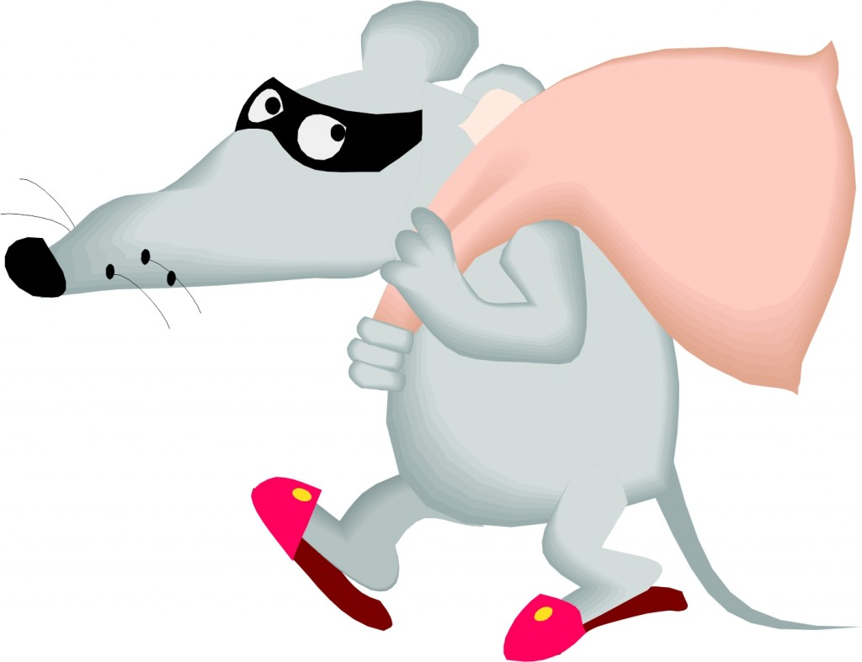
A Thief
A thief is a person who has stole something of value or something that you care about
They take things without asking and usually break or sell or keep if its money
They try to take money from people
It takes place at night because that’s when people sleep
They usually where black
They take peoples identity online and try to take money from them or try to be that person

Slide 3
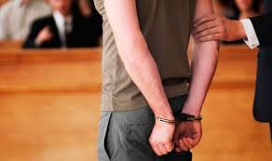
They need to be gone
Thieves need to stop because people worked for what they got and that is just taking it away and just for your wanting's
Some people may take action and get the police or get someone that can get it back
That is the right thing to do because those thieves are usually armed
Cops can sometimes be helped to get the person that stole but usually not the thing that was stolen

Slide 4
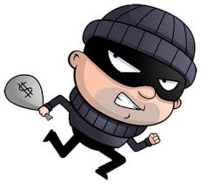
Who to contact
When it happens and you know call someone you know or the cops
You can choose who you think it is and they will get them
It may be hard to get a thief because they evade
When they try to get valuables you might have an alarm
If the alarm goes of the cops may get them

Slide 5
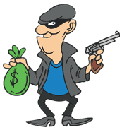
How to avoid
Every night close every door and window and make sure they are locked
When you here a break in you need to have a weapon or someone with you
If it is a group you need to stay hidden and have a weapon with someone
Getting stole from is better than your life being taken
You need to hide with a weapon because if they find you, you still to have something to keep you safe

Slide 6
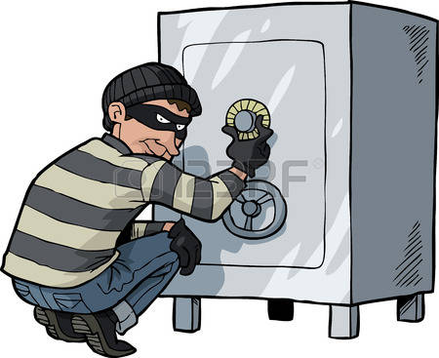
How often is it
Thieves strike way to often and there are TV shows about thieves
You need to lock stuff up to prevent it
Most stores have very high security when you try to leave
If you have something you have not paid for it will buzz when you leave

Slide 7
How much would it cost
Alarms are kind of pricy so it would be hard for some
Some people would think that it would not be good
I think it would because it would save peoples lives and It could lead to a better world
When you pay for it, it could save you and valuables so it cant get stolen
I think if this gets around soon then we could stop almost all thief's so if you want to stop stealing tell everyone to stay aware

Slide 8
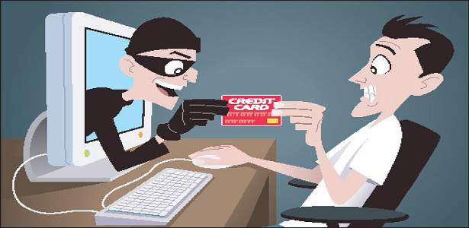
Internet Thief's
Internet thief’s they persuade you to buy something and scam you just for your account
They take your identity and bank account passwords and other passwords
They know where you live after you tell in a survey
They also can get your personal information

Slide 9
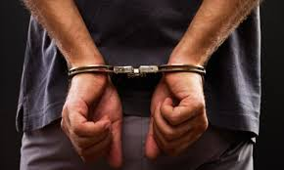
THE END

Slide 10
Sources
http://www.dictionary.com/browse/thief
https://www.google.com/search?q=thiefs&oq=thiefs&aqs=chrome..69i57j69i60j69i59j69i61l3.1488j0j7&sourceid=chrome&ie=UTF-8#safe=strict&q=theft+definition
https://www.google.com/search?q=thiefs&oq=thiefs&aqs=chrome..69i57j69i60j69i59j69i61l3.1488j0j7&sourceid=chrome&ie=UTF-8#safe=strict&q=theft+percentage

